Slide 1
Tsunami
Japan, 2011

Slide 2
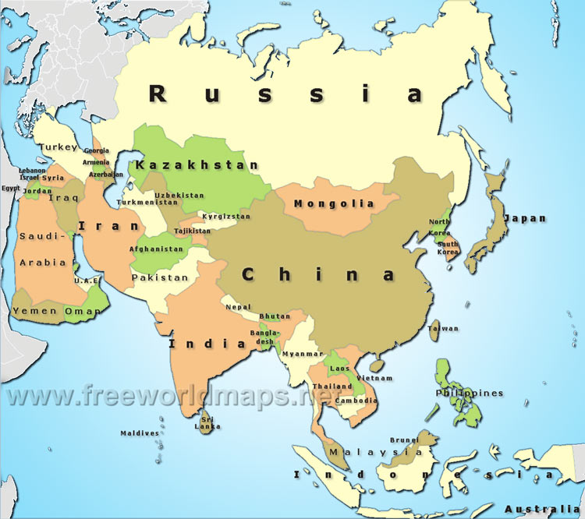
Where is Japan?

Slide 3
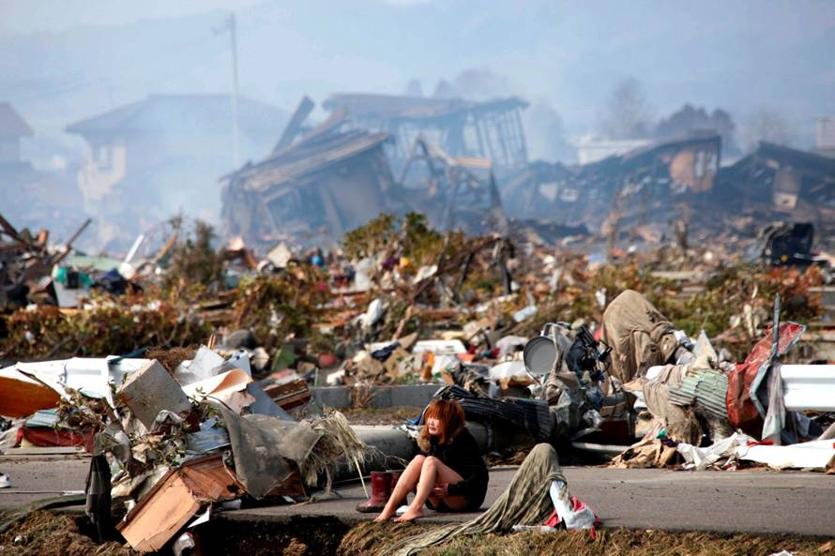
What happened in Japan in 2011?

Slide 4
Some questions to think about…
What is an earthquake?
What is a tsunami?
How was Japan affected?

Slide 5
Earthquakes
An earthquake
is caused by natural movements of the earth’s surface.
is a trembling or shaking movement of the earth’s surface.
Will it happen to Singapore? Why?
No, as Singapore is located far away from the
earthquake zones.

Slide 6
Tsunamis
A Tsunami
is a tall water wave
can exceed 15 metres in height
means harbour wave in Japanese
is usually caused by earthquake in the sea

Slide 7
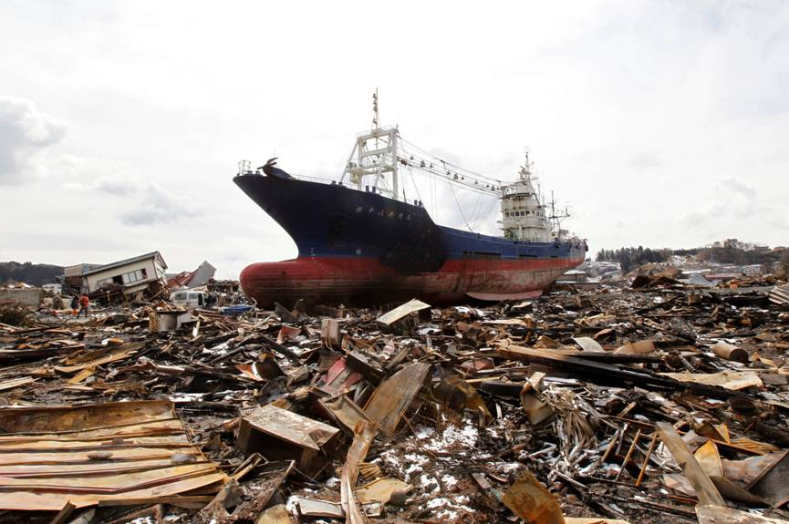
How did the ship end up inland?
The tsunami was so powerful that even a big ship was swept inland.
This also explains why several coastal towns were also practically damaged completely by the tsunami.

Slide 8
The tsunami that hit Japan measured up to 10m in height.

Slide 9
Impact of the Earthquake and Tsunami on Japan

Slide 10
Loss of Lives and Family Members
At least 11,232 people died, and 16,361 people went missing on 30 March 2011 (Tokyo National Police Agency).

Slide 11
Damage to Houses and Roads
The estimated cost was up to S$300 billion dollars of damage (1 billion is 1000 million)

Slide 12
Damaged Nuclear Power Station
A nuclear plant or power station is a place where nuclear energy is being produced and used to generate electricity.

Slide 13
Checking for Harmful Radiation
18,000 people living within 20km of the nuclear stations had to be moved away.

Slide 14
Effects on Agriculture
Nuclear pollutants fell on grass, water and soil, so farmers had to make sure the food was not contaminated.
Here, a farmer is disposing contaminated milk.

Slide 15
Japan-Before & After
Bridge in Ishinomaki, Miyagi in 2011 and 2013

Slide 16
Japan-Before & After
Rusted vehicles and tsunami debris in 2011 and cleared space in 2013.

Slide 17
Japan-Before & After
A sightseeing boat washed ashore by the tsunami in 2011 and the same house still in disrepair in 2013.

Slide 18
References
CPDD Package on Tsunami, Japan 2011
http://www.theatlantic.com/infocus/2013/03/japan-earthquake-2-years-later-before-and-after/100469/

